Slide 1
Adjusted Urban AREA Boundaries Review Process

Slide 2
Background
KYTC is responsible for reviewing Urban Area Boundaries for Federal Transportation Programs
“Adjusted Urban Area Boundaries”
Every 10 years
5,000+ population
KYTC seeks comments from local officials
Population 5,000 – 49,999
Elected officials of local governments
Population 50,000+
Elected officials of local governments acting through the Metropolitan Planning Organization (MPO)
Federal Highway Administration approval required

Slide 3
Impacts
Federal Transportation Programs that rely on a distinction between urban and rural areas
Highway Functional Classification – urban or rural
Transportation planning decisions
Federal-aid eligibility
Surface Transportation (STP) Apportionment Formula
Federal-aid eligible highways
Distribution of STP funds
Specific min. % must be spent in rural areas
Control of outdoor advertising on protected routes
Protected distance from right-of-way line
Reporting of highway statistics
Highway Performance Monitoring System (HPMS)

Slide 4
Starting Point
Urban Area Boundaries published by U.S. Census Bureau
Created based on…
Population density as collected in the 2020 Census
Urban land use data
County and City incorporated boundaries disregarded
Adjustments to the Census boundaries are not required

Slide 5
FHWA Adjustment Guidelines
Adjusted Urban Areas will…
Include the entire Census urban area
Be one single, contiguous area
Adjusted Urban Areas should…
Include areas within the urban footprint
Areas with urban transportation characteristics
Large traffic generators near the urban fringe
Be easily identified in the field
Physical features
Minimize boundary ambiguity and irregularities

Slide 6
Kentucky Process
Urban Area Boundary Review Team
KYTC Central Office Planning staff
KYTC District Office Planning staff
MPOs
FHWA Kentucky Division
The Review Team will…
Distribute guidance, maps, and GIS data to Local Planning Partners
Facilitate communication with Local Planning Partners
Review proposed boundary adjustments submitted by Local Planning Partners
Determine final boundary adjustment recommendations
Request approval from FHWA Kentucky Division

Slide 7
Proposed Schedule

Slide 8
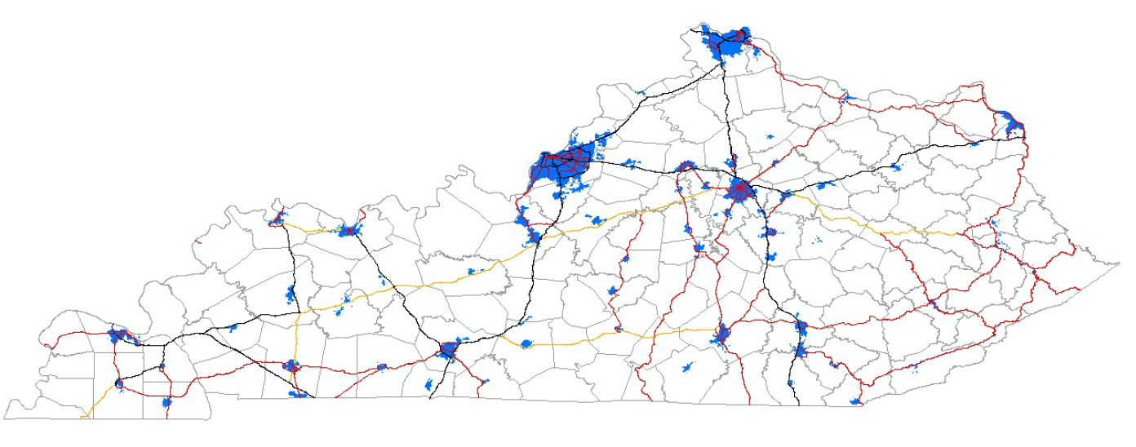
2020 US Census Urban Area Boundaries (Pre-Adjustment)
63 Urban Areas (9 MPOs)

Slide 9
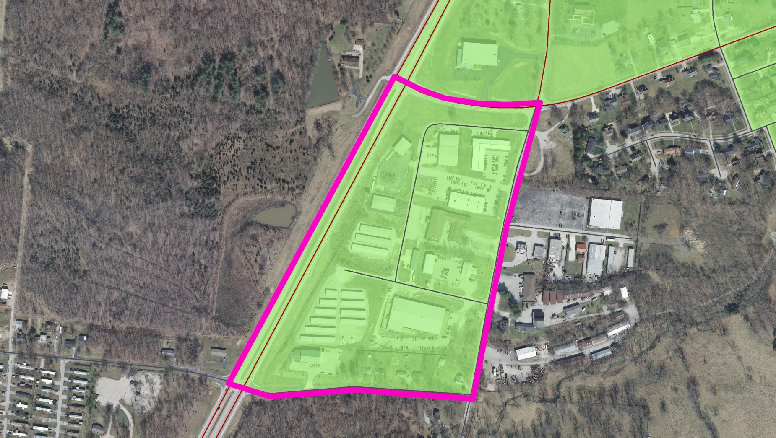
Adjustment Rule #1
The Adjusted Urban Area Boundary will encompass the entire urban area as designated by the Census Bureau.
Outward expansions only

Slide 10
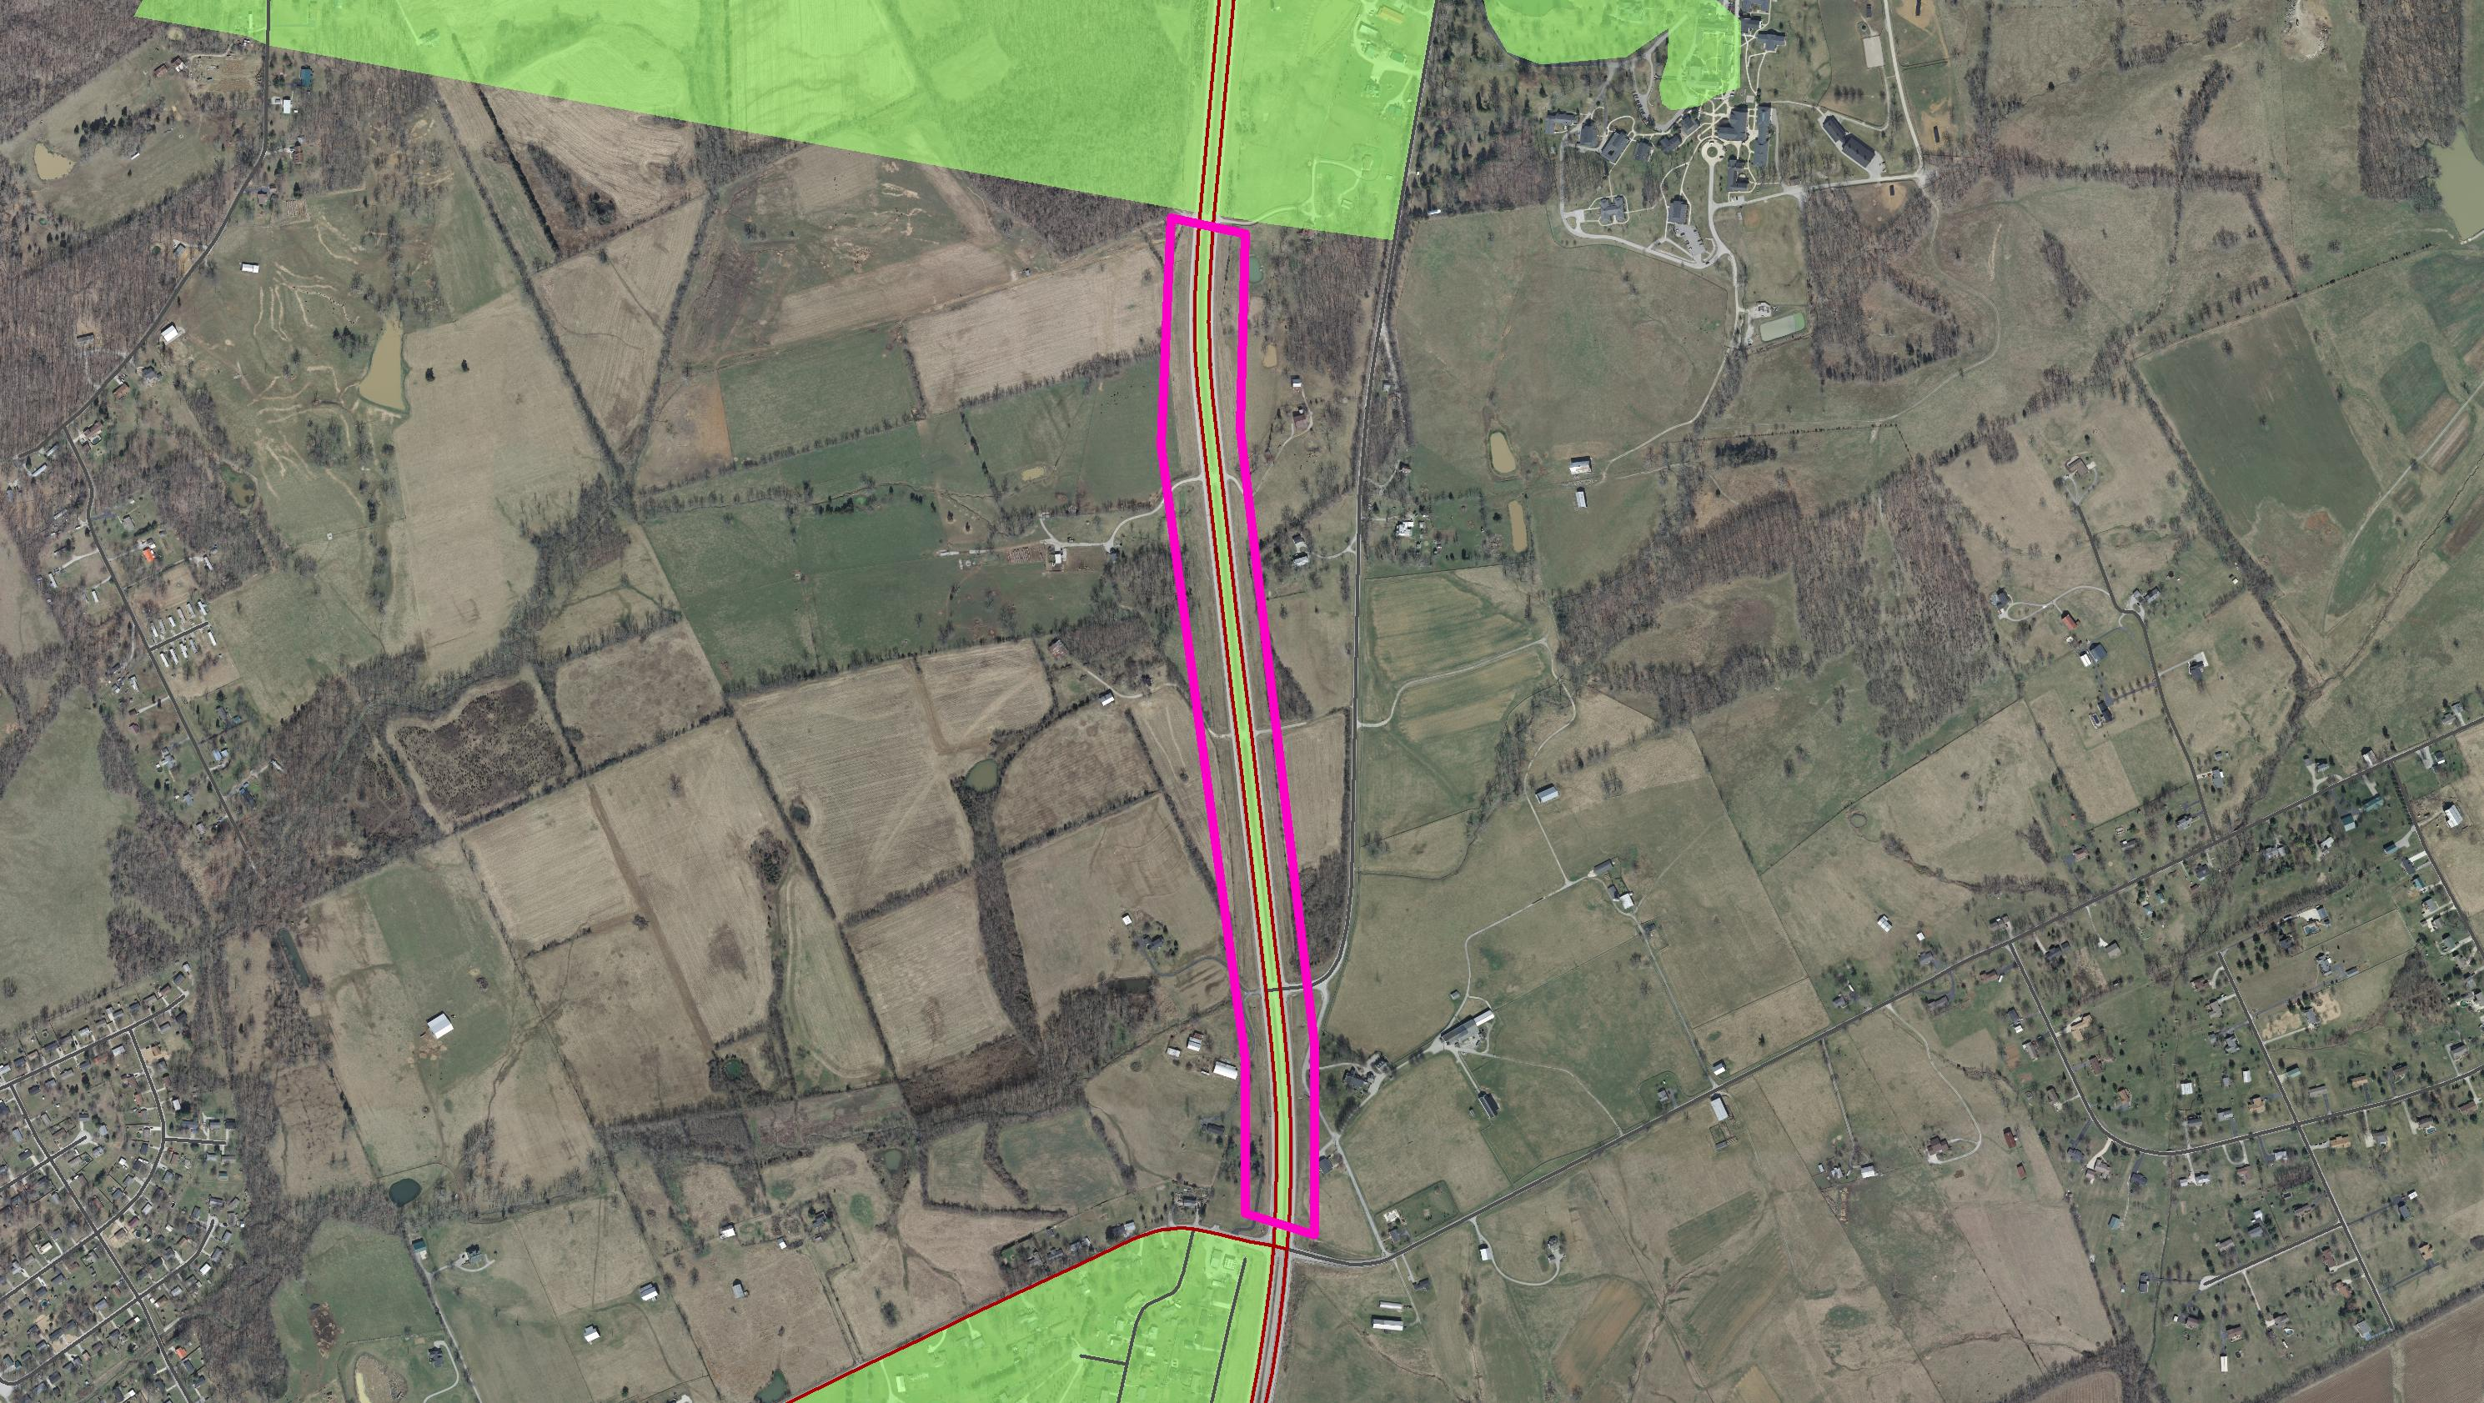
Adjustment Rule #2
The Adjusted Urban Area Boundary will be one, single contiguous area.

Slide 11
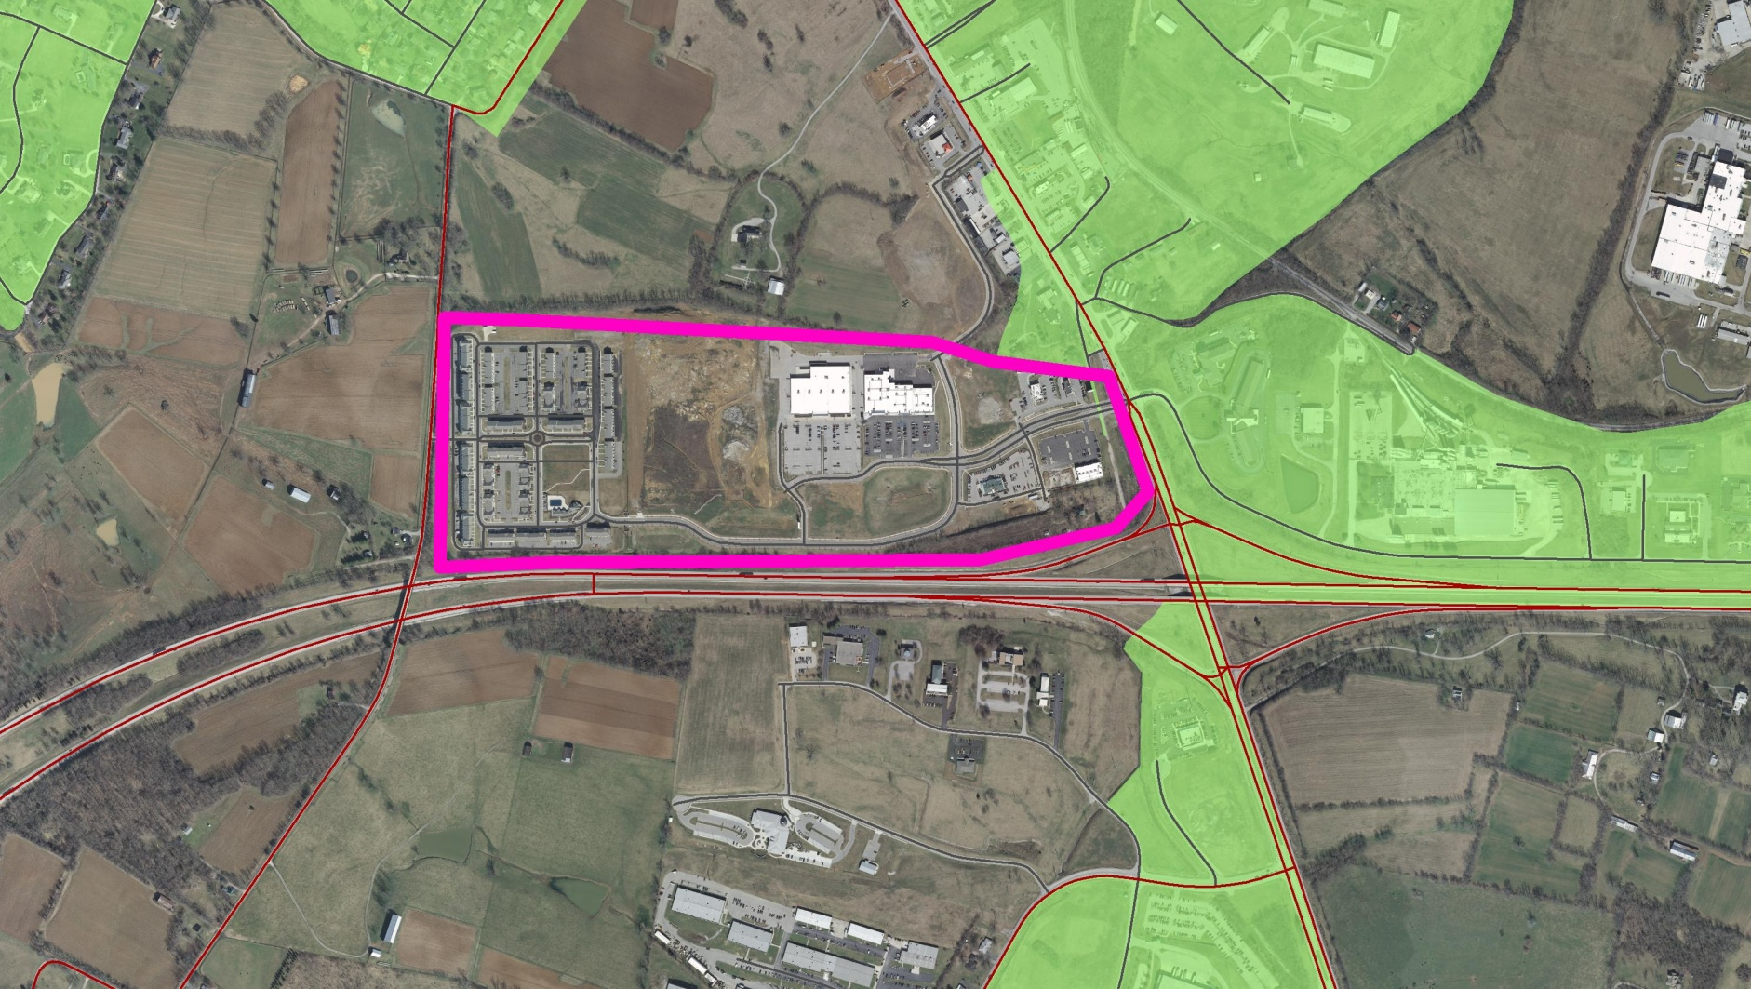
Adjustment Guideline #3
The Adjusted Urban Area Boundary should consider areas with urban characteristics: residential, commercial, industrial, national defense, or urban terminals (such as airports, rail or bus hubs, etc.)

Slide 12
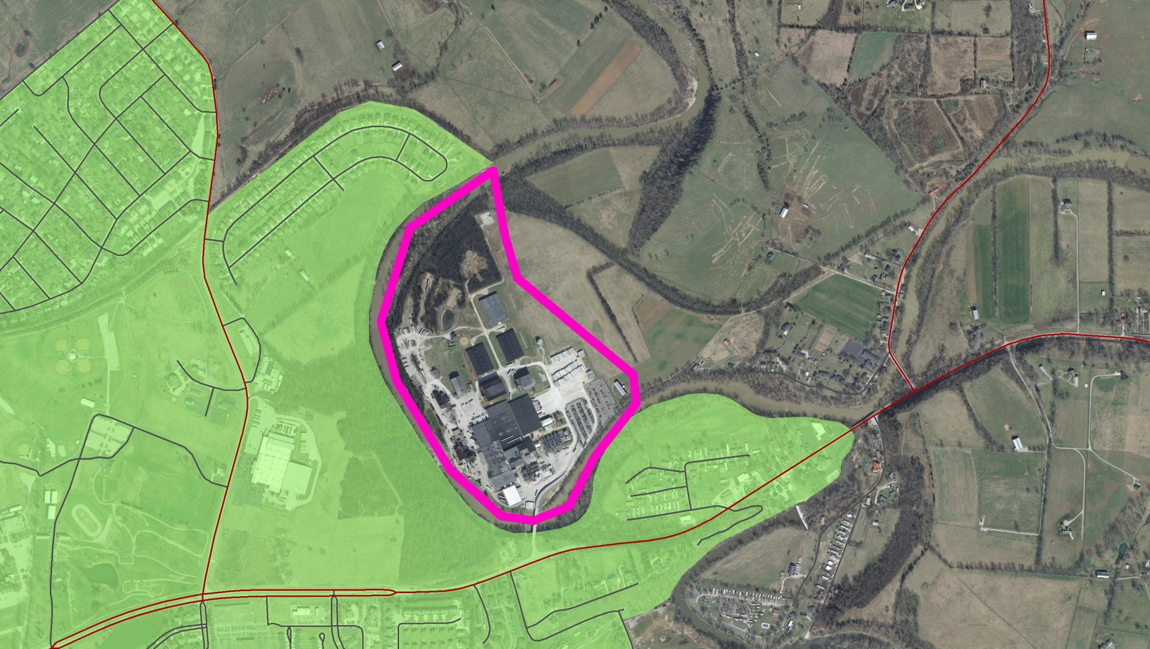
Adjustment Guideline #4
The Adjusted Urban Area Boundary should consider large traffic generators (such as fringe area public parks, large places of assembly, or industrial complex).

Slide 13
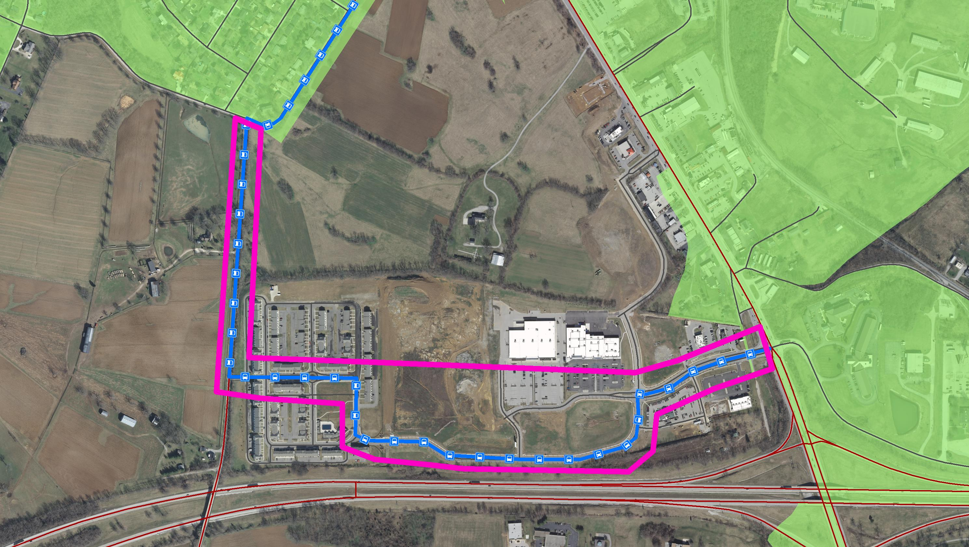
Adjustment Guideline #5
The Adjusted Urban Area Boundary should consider transit service routes.

Slide 14
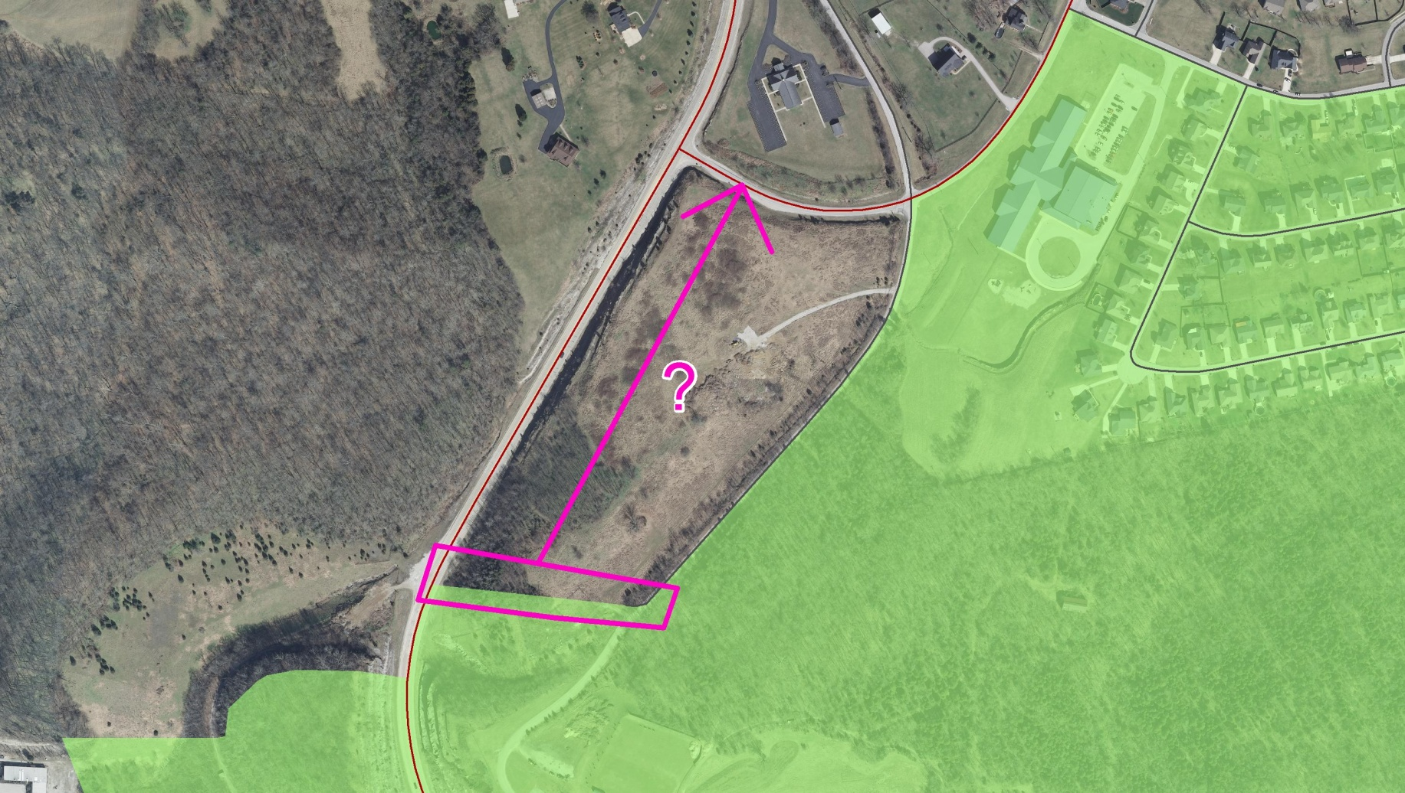
Adjustment Guideline #6
The Adjusted Urban Area Boundary should follow roads, streams, railroads, or other physical features so that its location is easy to distinguish in the field.

Slide 15
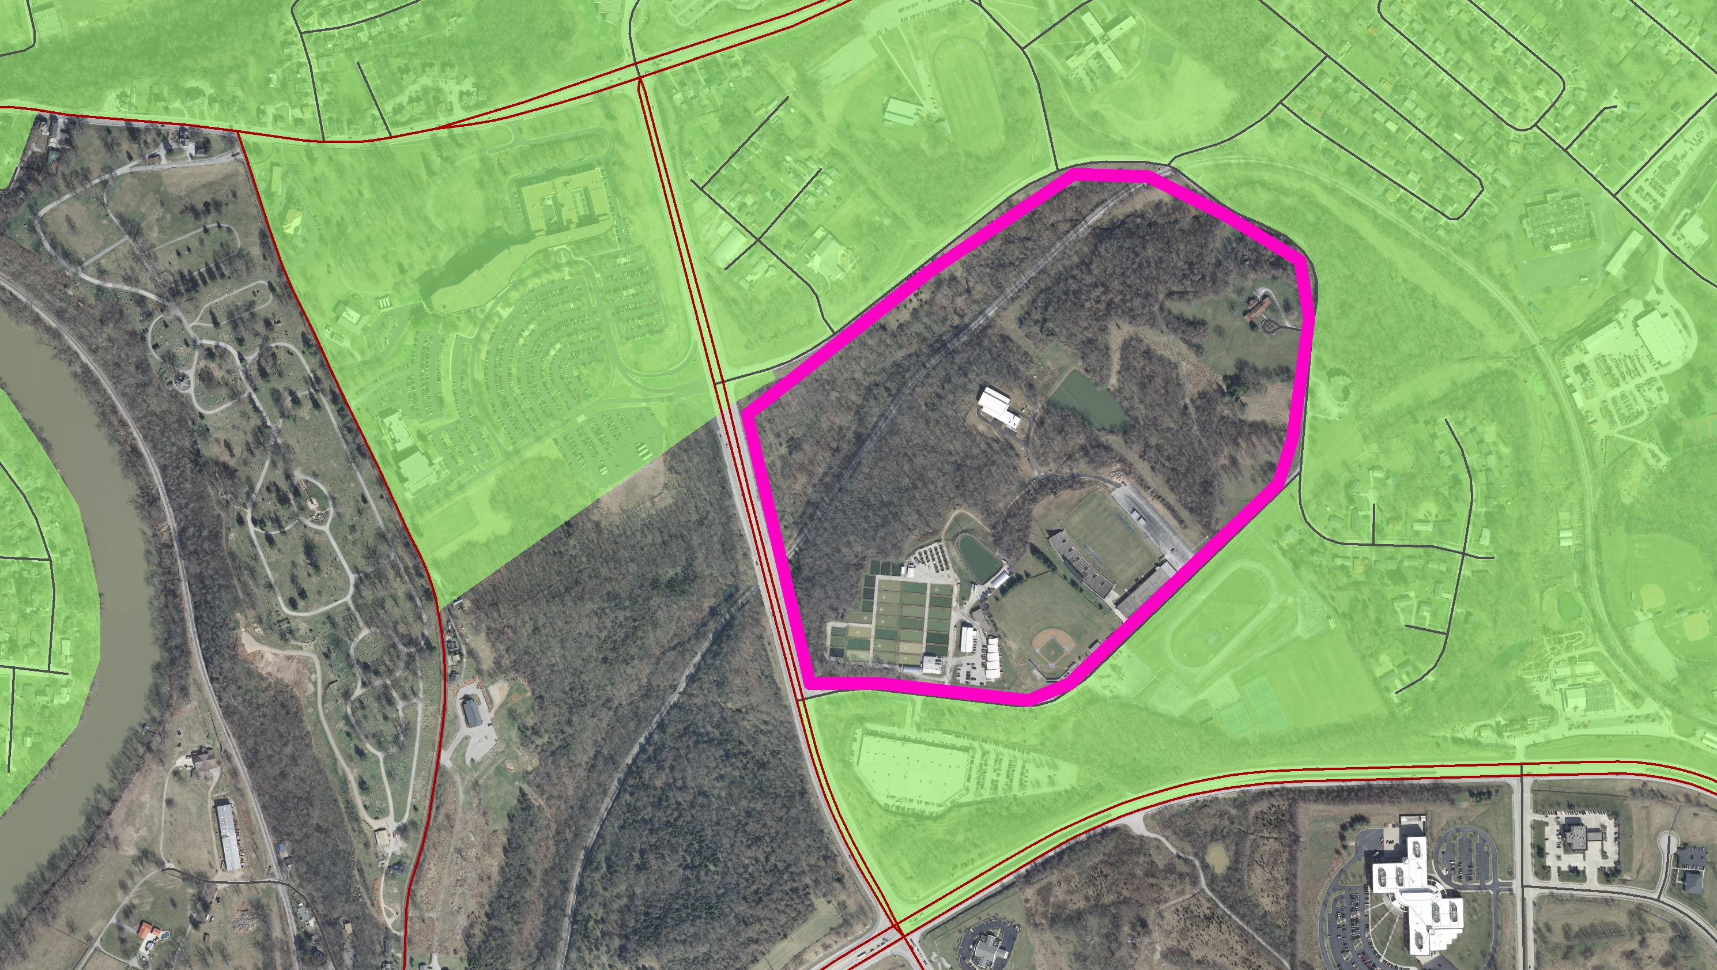
Adjustment Guideline #7
The Adjusted Urban Area Boundary should minimize irregularities.

Slide 16
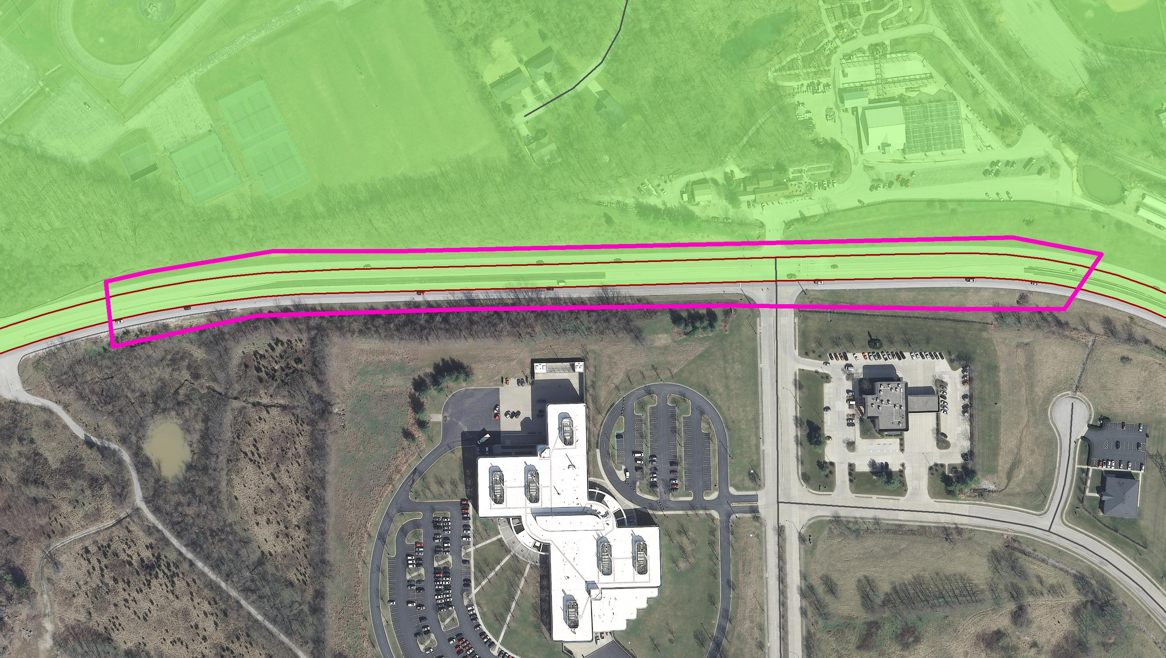
Adjustment Guideline #8
The Adjusted Urban Area Boundary should not be located in the middle of a divided highway.

Slide 17
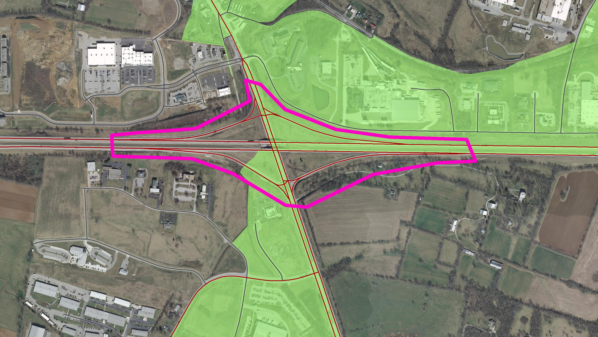
Adjustment Guideline #9
The Adjusted Urban Area Boundary should not divide an access controlled roadway. All ramps at an interchange should be either included or excluded.

Slide 18
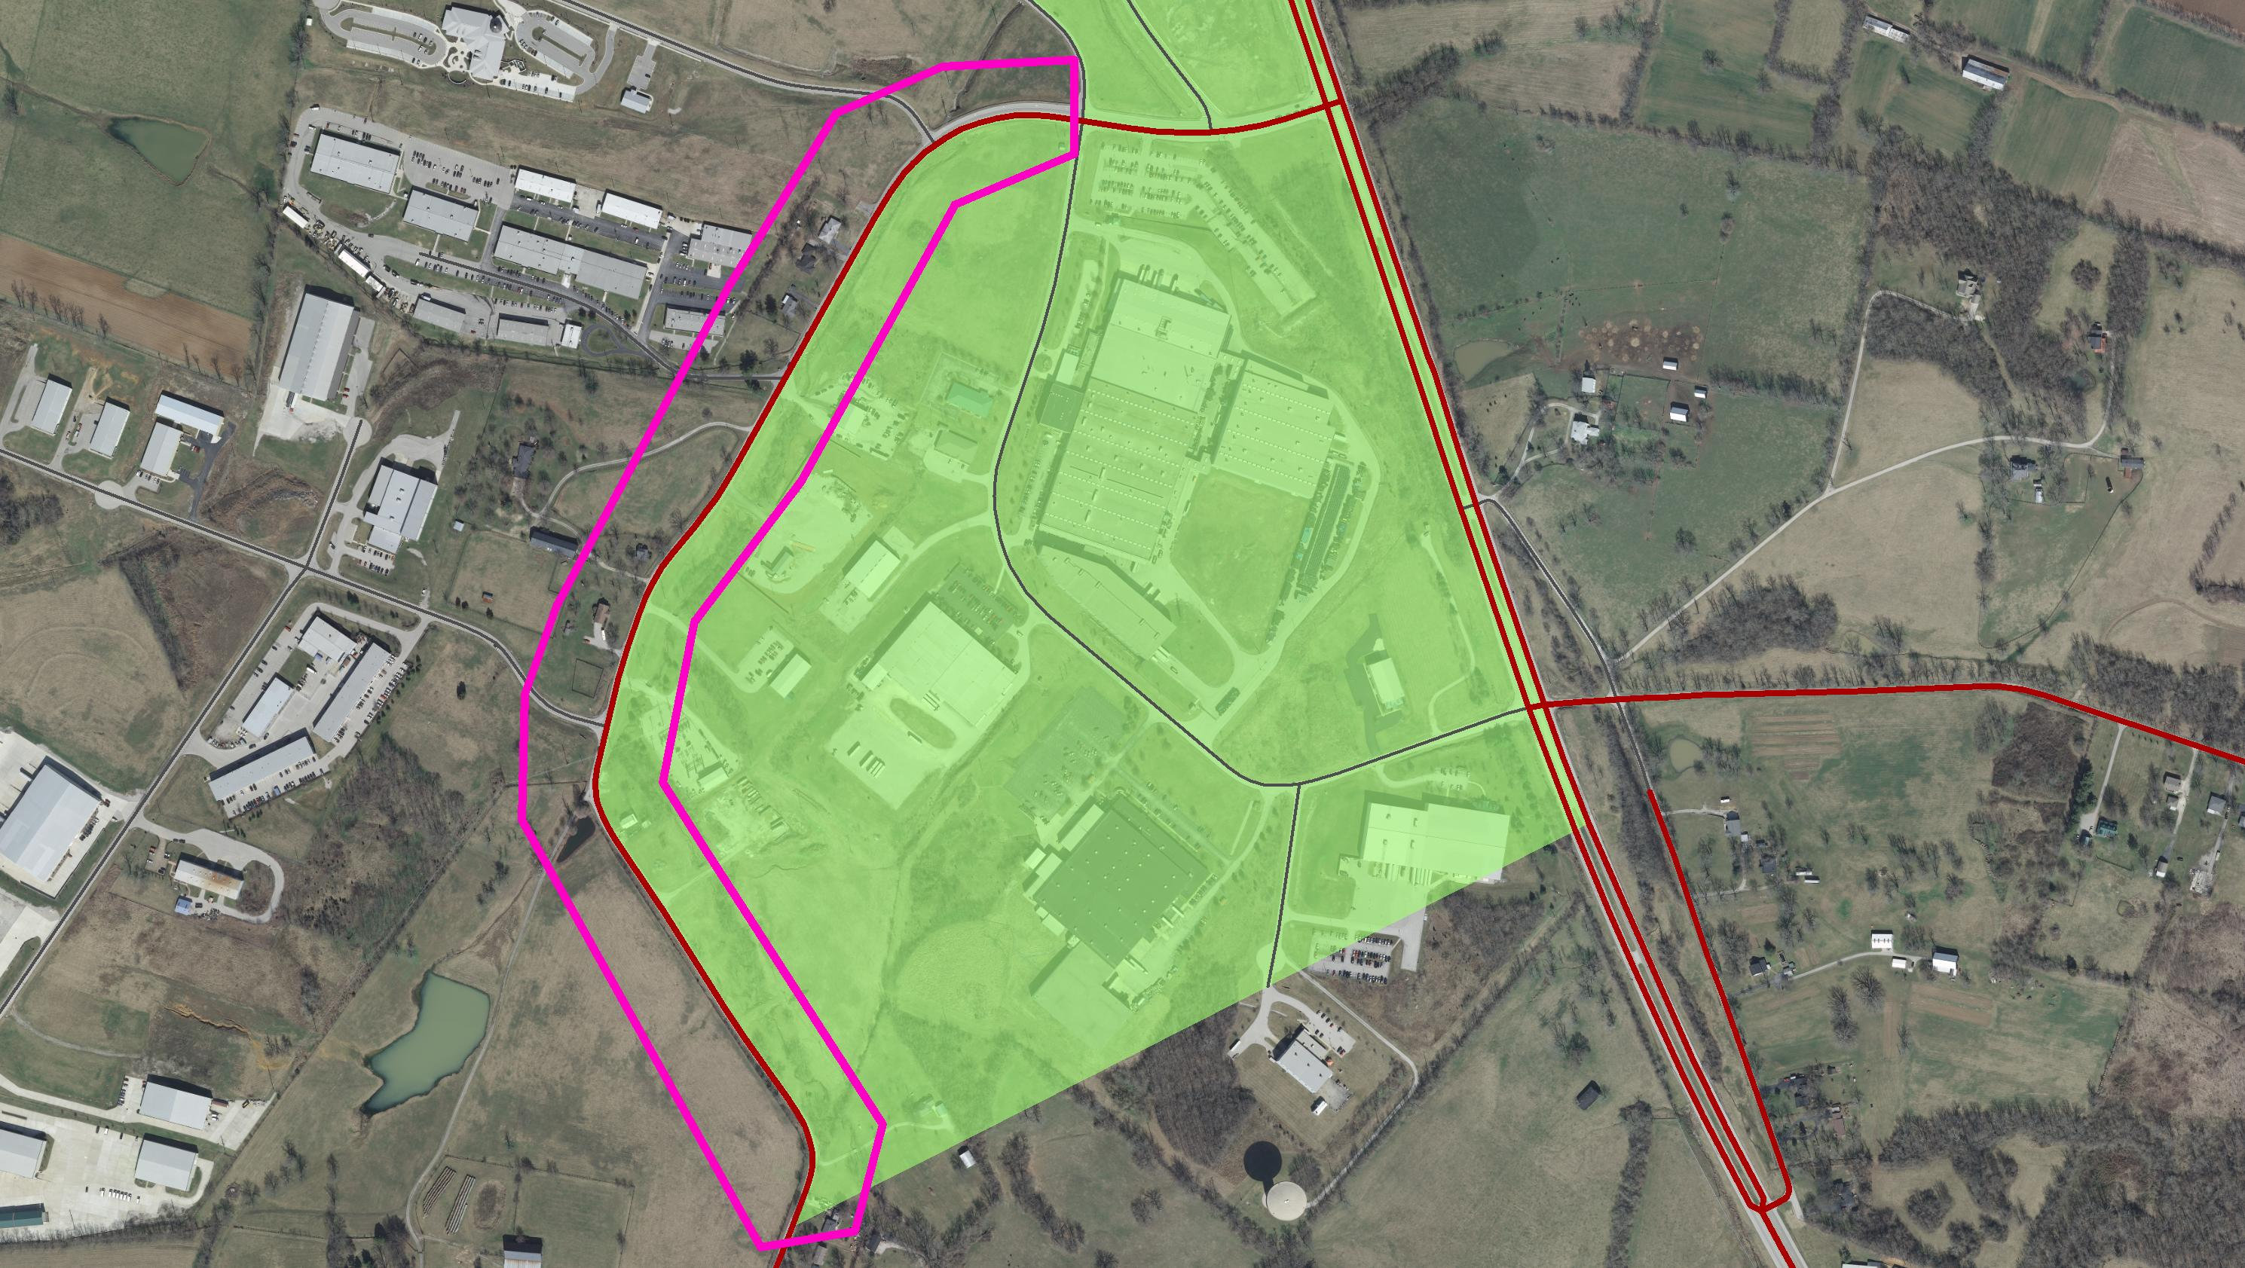
Adjustment Guideline #10
The Adjusted Urban Area Boundary should be defined so that a roadway is consistently urban or rural.

Slide 19
Questions and Answers

